Slide 1
LearnNova – A Digital Education Platform for Inclusive and Quality Learning
Presented by: Muskan Derwal (0187CS221129)
Prachi Kumari (0187CS221150)
Mahendra Ahirwar (0187CS221113)
Mentor: Prof. Shumali Gupta

Slide 2
Problem Statement
Students (Class 6–12) do not get all study material in one place.
Notes are not organized in categories like lesson notes, important points, and Q&A.
Students face difficulty in finding simple and understandable content.
There is no single platform for all subjects and chapters.
Limited platforms provide structured and affordable learning for school students

Slide 3
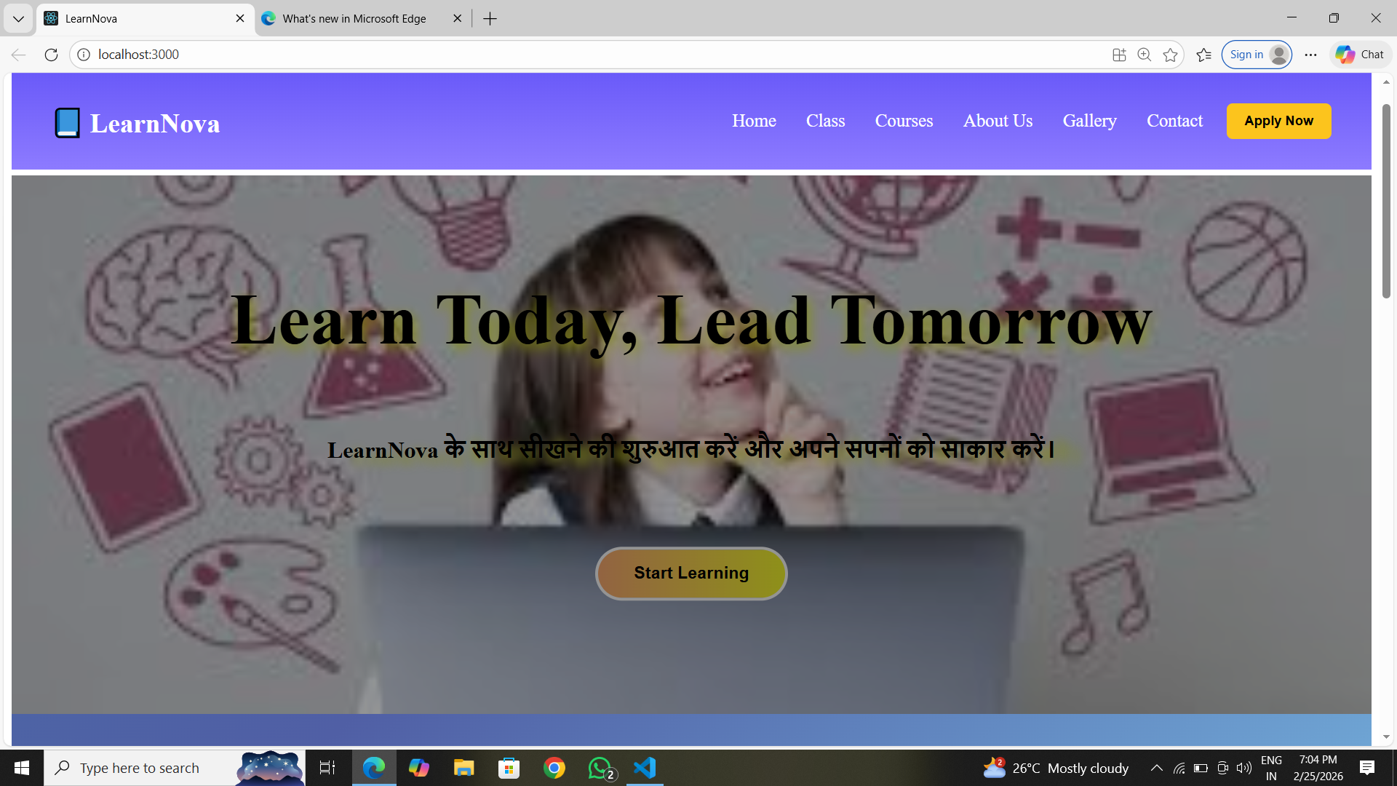
Solution
LearnNova is an online learning platform designed for school students.
It focuses on Class 6 to 12 with complete subject coverage.
It provides structured and easy-to-understand study material.
Our goal is to make learning simple, accessible, and engaging for every student.
Offer both free trial and paid subscription.

Slide 4
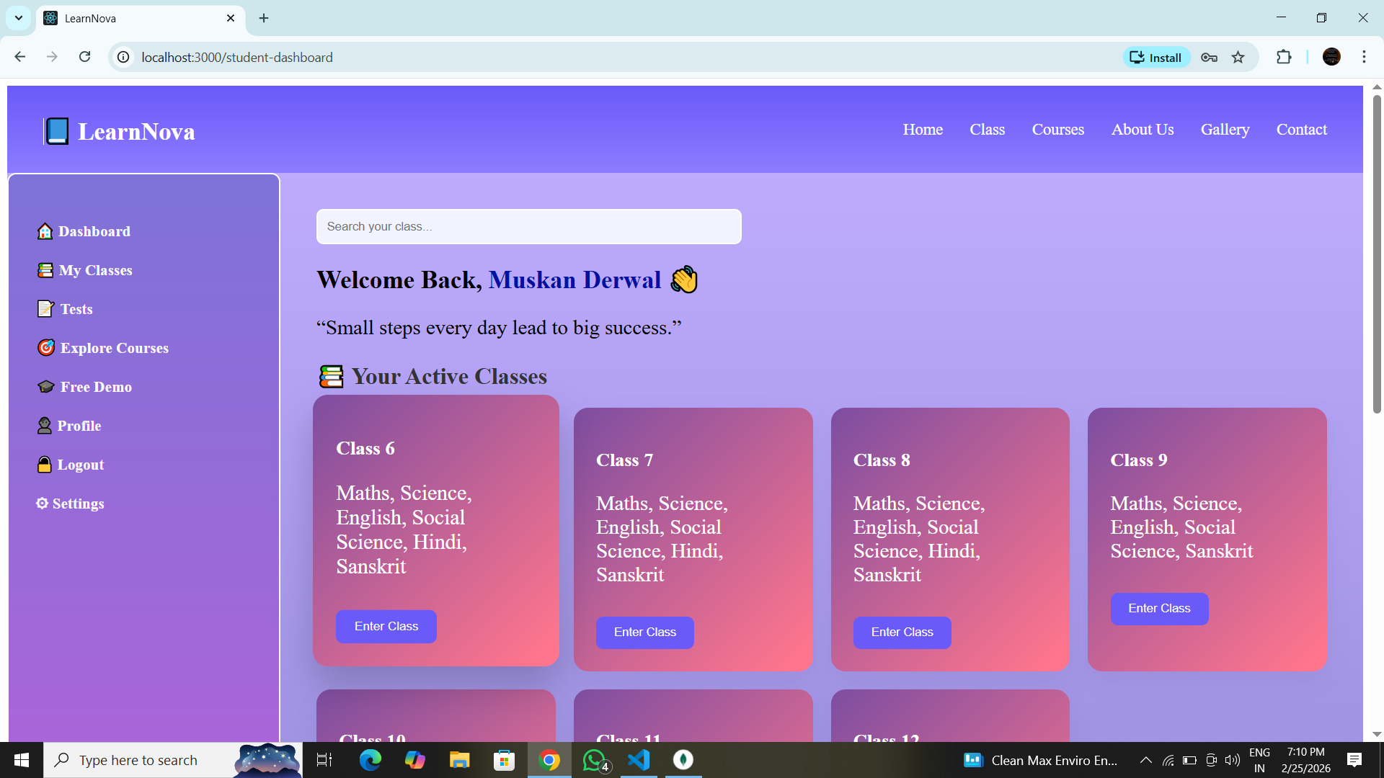
Technology Stack
FRONTEND | React.js
BACKEND | Node.js, Express.js
DATABASE | MongoDB
FILE UPLOAD | Multer (Notes & resources)

Slide 5
Key Features
Category-wise Notes:
01
Class-wise Content
02
Student Dashboard
03
User-Friendly Interface
04
Lesson Notes
Important Notes
Q&A
Video Lectures
All subjects & chapters (6–12)
Track progress easily

Slide 6
Benefits for Students
Learn anytime, anywhere
Well-organized and easy content
Better understanding through videos
Self-paced learning & improvement
Makes study simple and interesting

Slide 7
Future Scope
Expansion from Class 1 to 12
AI Chatboard for instant doubt solving
Live Classes for real-time interaction
Personalized learning using AI

Slide 8
Conclusion
LearnNova is a complete digital learning solution for school students.
It provides quality, structured, and accessible education.
It supports the idea of inclusive learning for all student.
Making learning easy, smart, and effective!

Slide 9
THANKS!
Empowering students through digital learning.
LearnNova – Making education simple, smart, and accessible.

